Slide 1


Leading Network Transformation
Timing & Sync Challenges in Cloud Based RAN Implementations(vRAN).
27st October, 2020

Slide 2

Disclaimer
This presentation is proprietary information of Altiostar Networks, Inc. The information contained herein may not be used to create or change any contractual obligation of Altiostar Networks, Inc. Any review, retransmission, dissemination or other use of, or taking of any action in reliance upon this presentation by persons or entities other than the intended recipients is prohibited. This presentation is for planning and information purposes only. The specifications contained herein are subject to change without notice.
Any information contained in Altiostar’s product roadmap is intended to outline our general product direction. It is intended for information purposes only, and may not be incorporated into any contract. This does not constitute a promise or obligation of delivery of any product, feature, functionality or service and should not be relied upon in making purchasing decisions. Altiostar, at its sole discretion, and without notice, reserves the right to alter the design, specifications, and forecasted time to market of all of its products and services on any roadmap, at any time, as part of its continuing program of product development.

Slide 3
Agenda
Cloud/Distributed RAN architecture
Time sync challenges in vRAN deployements
  Timing unware DU and sync propagation.
  TAE challenges across RUs with GNSS based sync.
  Sync plane Management for DU/RUs in FH network.
  Clock Source redundancy for cell availability.
  Holdover characteristics of RUs.
  Single Point Of Failure on FH network.
  Longer clock chains in shared cell architecture.
  Sync Plane management in shared RU architecture
Final Thoughts
Q & A

Slide 4




Cloud/distributed RAN architecture

Slide 5
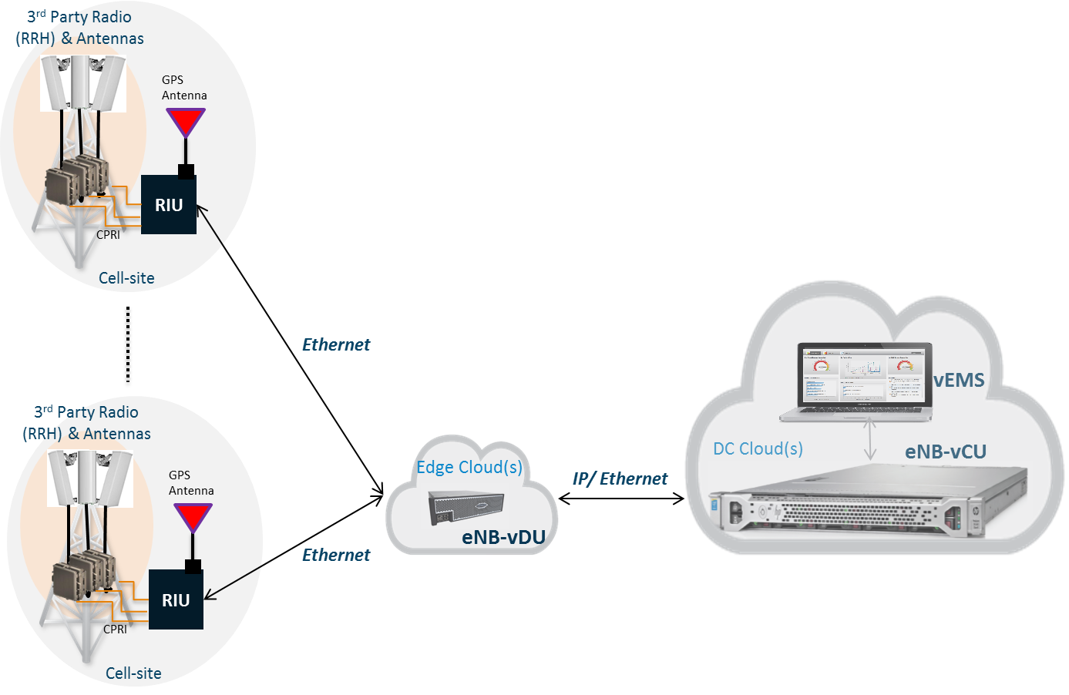
Cloud/Distributed RAN architecture
Figure-1: vRAN Architecture

Slide 6
Cloud/Distributed RAN architecture
As illustrated in Figure 1, vRAN architecture consists of eNB-CU (Centralized Unit), eNB-DU ( Distributed Unit), vEMS (virtual EMS), RU (Radio Unit) and 3rd party RRH (Remote Radio Head) & Antennas.
Cell-site may have multiple 3rd party RRHs/Antennas connected to a single RU over CPRI. Multiple such RUs interface with a single instance of an eNB-DU, which can be run in an edge data center cloud. Multiple such eNB-DU instances interface with a single instance of an eNB-CU, which can be run in a centralized data center cloud. Multiple such eNB-CU instances interface with a single instance of vEMS, which can be run in a centralized data center cloud.
eNB-DU and eNB-CU can be run in the same data center cloud.
RUs need sync for maintaining phase/freq/sync for IQ symbols, PRACH processing, CPRI data transmission.
DUs needs sync for maintaining L1 symbol timing(SFN) based on the sub carrier spacing needed.

Slide 7
Time Sync Challenges

Slide 8
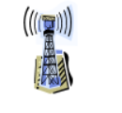
Sync propagation in Timing unaware
For Timing unaware DU, sync info is needed for deriving SFN and maintaining symbol timing.
RU might need to send timing info in IQ extensions on FH network.
Any delays in FH network might impact symbol timings.
Switches in the FH network might need proper dimensioning of QoS to keep this FH delays minimal so as to keep accurate symbol timings.
Each RU propagates timing info to DU in IQ pkt extensions continously.
CPRI
IQ data with Timing info
RU1
DU
eCPRI
eCPRI
RU2
IQ data with Timing info
CPRI

Slide 9
TAE challenges across RUs with GNSS based sync

Slide 10
TAE between Radio Ports across RUs.
Time Alignment Error between any two radio ports across RUs need to be within the 3GPP specified limit for a chosen Air Interface Target.
RUs with GNSS based sync shall be compliant to G.8272 Class-A/Class B compliant with TE +/-100ns, +/- 40ns.
Certain Air Interface targets like MIMO needs TAE between radio ports of RUs to be as low as 65ns.
Challenge to maintain the TAE within the specified limit with GNSS based sync at all times.
Need highly accurate GNSS receivers with Time Error as low as possible down to 5ns.
CPRI
CU traffic
RU1
DU
eCPRI
TE=+40ns
eCPRI
TAE > 65ns
RU2
TE=+35ns
CU Traffic
CPRI

Slide 11
Sync plane management of DU/RUs in FH network

Slide 12
Sync plane mgmt of DU/RUs in FH network
GPS
Needs capabilities to monitor S Plane events from DU for any state changes inorder to take any reactive steps.
Capability for RU to update S plane state info to DU for any clockClass, clockQuality, GPS failure, any catastrophic events leading to RU losing lock.
DU to be able to update S plane info to all connected RUs.
Need to ensure mgmt plane info is not lost through the switches since these msgs are less frequent.
CPRI
RU1
DU
M plane updates
RU2
T-TSC
M Plane updates
CPRI

Slide 13
Clock source redundancy for cell availability

Slide 14
Clock Source redundancy for cell availability
DU/RU equipped with GNSS as sync source might not be reliable always due to GPS prone to faults like multipathing, jamming, signal blockage due to tree canopies, environmental conditions, bad cabling etc.
GNSS faults at DU/RU impacts the cell operations due to sync plane going down.
Need for clock source redundancy as alterate clock source for switchover to backup sync in case of GPS faults.
Challenges during the clock switchovers as transient response during the switchover might impact the cell operations and need to be kept minimal. Impact will be high if backup source is transported through longer chain of ptp unware switches/routers.
Might also impact cell hand offs as UEs move from one cell to another.
T-GM
CPRI
RU1
Switch
CUS traffic
TE=+40ns
RU2
CUS traffic
TE=+35ns
CUS plane
DU
CPRI

Slide 15
Holdover Characterisitics of RU

Slide 16
Holdover characterisitics of RUs.
RUs with GNSS based sync without back up clock source goes to holdover/free-run
Typically RUs will have short holdover periods due to low quality oscillators being used for cost reasons.
Short holdover periods of RUs leads to bringing down the cells.
One RU in the network going out of sync might impact cells of all the RUs connected to DU since TAE drifts faster on the affected RU and causing all cells going down.
Need for RUs equipped with high quality oscillator to mitigate the sync loss impact. Trade off cost vs service impact?
CPRI
CU traffic
RU1
DU
eCPRI
eCPRI
RU2
CU Traffic
CPRI

Slide 17
Single Point of Failure on FH network

Slide 18
Single Point of Failure on FH network
GM2
For packet based synchronization using PTP+SyncE, unlike routers/switches ability to carry PTP and SyncE on multiple ports, RUs/DUs with single FH port, carries PTP and SyncE on same link and this causes single point of failure due to absense of alternate sync path.
Need for adding FH ports/links to DU/RUs for achieving FH redundancy to have alternate sync path.
Trade off: redundancy vs cost?
GM1
Switch-1
Switch-2
CUS Traffic
CUS Traffic
DU
RU1
RU2

Slide 19
Longer clock chains in shared cell architecture

Slide 20
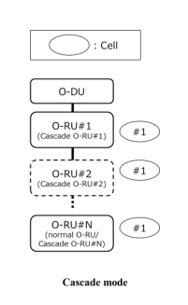
  Longer clock chains in shared cell architecture.
In shared cell architecture (where cell can have one or multiple carriers by several RUs with multiple cells) in cascaded mode with each RU in the chain acting as BC /TC except last RU(T-TSC).
For the case DU syncing from network(acting as T-BC), clock quality dteriorates as it is transported over chained RUs from DU.
Challenges to maintain clock accuracy within +/- 1.5us till the last RU in the chain.
Need for tighter clock accuracy(Class-C/D) for each RU.

Slide 21
Sync Plane Management for shared RU deployement

Slide 22
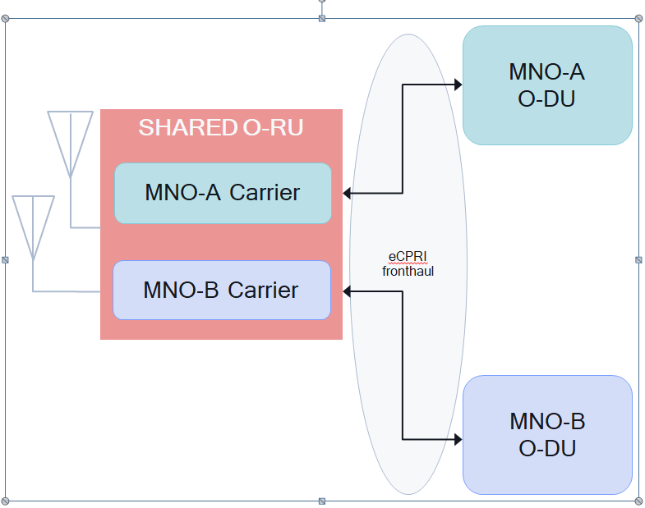
  Sync Plane mgmt for shared RU deployement
Shared RU deployement use-cases: RAN sharing, MORAN, Neutral host, Network slicing, MORAN.
In shared RU architecture where RU is shared by multiple DUs challenges arise as who should be owning sync plane?(MNO-A/MNO-B)?
MNO-A specific provisioning impacting MNO-B sync plane requirements (say TDD for MNO-A, FDD for MNO-B).

Slide 23
Q & A

Slide 24


Thank You

